Slide 1
Recap on Modern Electronic Theory of atoms

Slide 2
Bohr Model of the Hydrogen atom
Historically, Bohr’s model of the hydrogen atom is the very first model of atomic structure that correctly explained the radiation spectra of atomic hydrogen.
It introduced an early quantum theory, which brought about new developments in scientific thought and later culminated in the development of quantum mechanics.
The 19th century’s discoveries of absorption and emission spectra prompted the formulation of the model.

Slide 3
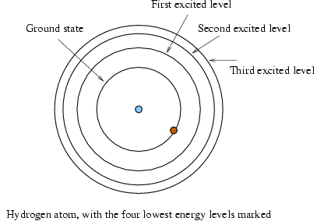
The Hydrogen Atom
The atom absorbs a quantum of energy
The electron travels to a higher energy level
It falls back to the original energy level and gives off an equal amount of energy as light - Photon
Equantum = Ephoton

Slide 4
Dual Nature of Light
Electromagnetic (EM) radiation is an electric and magnetic disturbance traveling through space at the speed of light (2.998 × 108 m/s).
It contains neither mass nor charge but travels in packets of radiant energy called photons, or quanta.
EM radiation are classified by wavelength into radio waves, microwaves, infrared, ultraviolet, the visible region we perceive as light, gamma and x-rays.
Some sources of EM radiation include sources in the cosmos (e.g., the sun and stars), radioactive elements, and manufactured devices.

Slide 5
Dual Nature of Light
Electromagnetic radiation can be described in terms of a stream of mass-less particles, called photons.
each traveling in a wave-like pattern at the speed of light.
Each photon contains a certain amount of energy. The different types of radiation are defined by the amount of energy found in the photons.
Radio waves have photons with low energies,
microwave photons have a little more energy than radio waves, infrared photons have still more,
then visible, ultraviolet, X-rays, and, the most energetic of all, gamma-rays.

Slide 6
Dual Nature of Light
Light has some tiny group of particles known as photons. These particles consist of higher energy, which is also called the quantum of radiation.
Therefore, light is made up of packets of energy or quantum of energy.
Einstein was the first to suggest that light is both a wave and a particle. This is called the wave-particle duality of light.
The wave-particle duality is the fundamental concept behind quantum mechanics and the reason for the development of solar cells and electron microscopes.
According to the Photoelectric effect, when a metal surface is irradiated with light of sufficient energy, it causes the electrons of the metal to eject out!

Slide 7
Dual Nature of Light
What is the threshold frequency?
Threshold frequency is defined as the minimum frequency that is required for radiation such that photoelectric effect is produced.
Which metals exhibit photoelectric effect?
Alkali metals are usually used for exhibiting photoelectric effect.
Metals such as copper and sodium are examples of metals that exhibit photoelectric effect.
What type of light is needed to cause the photoelectric effect?
Ultraviolet light is the type of light that is needed to cause the photoelectric effect.
What are the applications of photoelectric effect?
The applications of photoelectric effect are electric eye in door openers, light meters in photography, photostatic copying, and solar panels.
Planck’s law helps us to calculate the energy of a photon when its frequency is known.

Slide 8
Dual Nature of Light
The classical view of light was purely a wave phenomenon and particularly supported by the observation of the diffraction of light.
Planck & Einstein showed that light behaves as a particle using the concept of Photoelectric Effect.
The photoelectric effect is a phenomenon where electrons are emitted from the metal surface when light of sufficient frequency is incident upon it.
Einstein explained that light actually comes in packets (photons). And the amount of energy in a photon is given by the equation;
E = mc² (Einstein); m=mass, c=speed of light (3 x 10⁸ms⁻¹)
E_{photon} = hf (Planck) = mc² (f= frequency, h = planck’s constant as 6.626 x 10 ⁻³⁴ J.s)
Since v=fl, (f= v/l),
then
E_{photon} = hv/l The Bohr model is the beginning to the process of treating matter (electrons) as a wave.
(l=wavelength, v= speed of usually light – so can also be taken as ‘c’)

Slide 9
Dual Nature of Light
Question
1) Determine the energy of a photon of light that is emitted by light with a frequency of 1.42 x 10¹⁸ s-. The value of Planck’s constant is 6.626 x 10 ^{– 34} J•s.
Answer: 9.41 x 10 ^{– 16} J
2) Green light has a wavelength of 525 nm. Determine the energy for the green light in joules.
Solution
To find the Frequency;
c=λ×v
v= 3×10⁸ ms⁻¹ (1nm = 1 x 10⁻⁹m)
525x10⁻⁹m
Hence,
v=5.71×10¹⁴/s
To find the Energy;
E = h×ν
= (6.626×10⁻³⁴J.S) × (5.71×10¹⁴s⁻¹)
= 3.78 x 10⁻¹⁹J

Slide 10
The Spectral Lines of Hydrogen
Johannes Rydberg was a Swedish physicist who attempted to find a mathematical relationship between one spectral line and the next of certain elements.
He eventually discovered that there was an integer relationship between the wavenumbers (1/λ or ⊽) of successive lines.
His findings were combined with Bohr's model of the atom to create this formula:
1/λ = R(1/n₁² - 1/n₂²)
where
λ is the wavelength of the photon (1/wavelength = wavenumber ) R = Rydberg's constant (1.097 x 10⁷ m⁻¹) n₁ and n₂ are integers where n₂ > n₁.

Slide 11
The Spectral Lines of Hydrogen
The Rydberg formula may be applied to hydrogen to obtain its spectral lines.
For atoms with multiple electrons, this formula begins to break down and give incorrect results.
Setting n₁ to 1 and running n₂ from 2 to infinity yields the Lyman series. Other spectral series may also be determined:

Slide 12
The Spectral Lines of Hydrogen
Example: Find the wavelength of the electromagnetic radiation that is emitted from an electron that relaxes from n = 3 to n = 1.
Solution
1/λ = R(1/n₁² - 1/n₂²)
where n₁ is 1 and n₂ is 3.
Rydberg's constant: 1.9074 x 10⁷ m⁻¹
1/λ = (1.0974 x 10⁷)(1/1² - 1/3²) 1/λ = (1.0974 x 10⁷)(1 - 1/9) 1/λ = 9754666.67 m⁻¹ 1 = (9754666.67 m⁻¹)λ 1 / 9754666.67 m⁻¹ = λ λ = 1.025 x 10⁻⁷ m

Slide 13
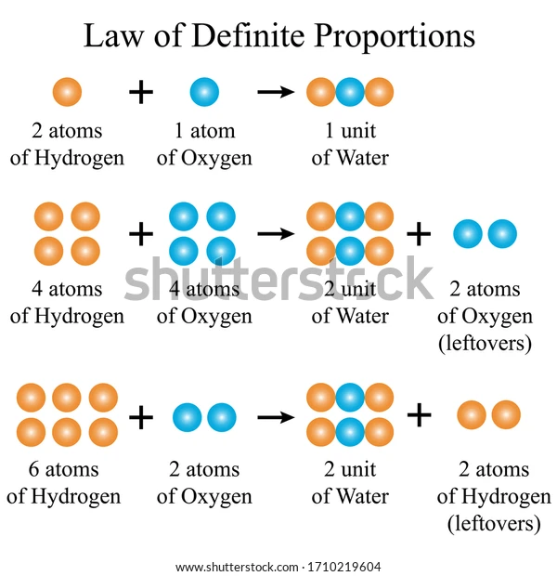
Law of Constant composition or Law of Definite Proportion

Slide 14
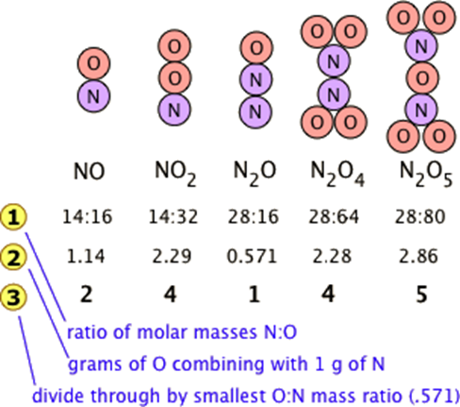
Law of Multiple Proportion
Many combinations of elements can react to form more than one compound.
In such cases, this law states that the weights of one element that combine with a fixed weight of another of these elements are integer multiples of one another
Nitrogen forms a very large number of oxides, five of which are shown here.

Slide 15
Law of Multiple Proportion
The law of multiple proportions states that if two elements form more than one compound between them, the masses of one element combined with a fixed mass of the second element form in ratios of small integers (whole numbers).
Question
Consider two separate compounds formed by only carbon and oxygen. The first compound contains 42.9% carbon and 57.1% oxygen (by mass) and the second compound contains 27.3% carbon and 72.7% oxygen (again by mass). Is this consistent with the law of multiple proportions?

Slide 16
Thus for every 1 g of the first compound there are 0.57 g of oxygen and 0.429 g of carbon. The mass of oxygen per gram carbon is:
0.57g of O = 1.33g of O/g of C
0.429g of C
Similarly, for 1 g of the second compound, there are 0.727 g oxygen and 0.273 g of carbon. The ration of mass of oxygen per gram of carbon is
0.727g of O = 2.66g of O/g of C
0.273g of C
Dividing the mass of oxygen per g of carbon of the second compound:
2.66 = 2
1.33
Hence the masses of oxygen combine with carbon in a 2:1 ratio which s consistent with the Law of Multiple Proportions since they are whole numbers.

Slide 17
Electronic Configuration, Periodicity and Building of Periodic Table

Slide 18
Table Outline
Overview of atoms
Energy levels & Quantum numbers
Electronic configuration & guiding principles
The Shielding Effect and Effective Nuclear Charge
Understand how periodic table came to be
Relate electron configurations to element classifications in the periodic table and their atomic properties

Slide 19
Learning Objectives/Outcomes
By the end of this section, students will be able to:
Understand the concept of an atom and its orbiting electrons.
Understanding Quantum numbers and important principles guiding electronic configuration
Determine the electron configuration for elements and ions, identifying the relation between electron shells and subshells.
Derive the predicted ground-state electron configurations of atoms
Identify and explain exceptions to predicted electron configurations for atoms and ions
Understand Shielding effect and calculate effective nuclear charges experienced by valence electrons.
Understand how periodic table came to be
Relate electron configurations to element classifications in the periodic table and their properties
Notes:
The specific arrangement of electrons in orbitals of an atom determines many of the chemical properties of that atom.

Slide 20

Atoms in Molecules
An atom is the smallest constituent of an element that retains the properties of that element. Smallest possible unit/amount of matter that retains its identity as a chemical element.
When combined, atoms form molecules which interact to form gases, liquids or solids e.g. H₂O.

Slide 21
Atoms in Molecules
Several biological processes break down molecules into their constituent atoms to be reassembled into molecules that are more beneficial in the body.
For example, the carbohydrates, proteins & lipids from our foods are reassembled in a suitable form, different from other animal or plant versions.
Another example is the breakdown of glucose in the formation of required energy in form of ATP. C₆H₆O₆→ATP .

Slide 22
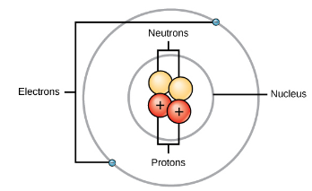
Atoms and subatomic particles
An atom consists of a nucleus centre comprising protons (positive charge) & neutrons (neutral charge), that are surrounded by moving electrons (negative charge).
There are two main atomic regions: the nucleus center (proton & neutron), and the outer region that holds its electrons in orbit at some distance around the nucleus.
Atomic diameter – 10⁻¹⁰m
Nuclear diameter – 10⁻¹⁵m
Protons and neutrons have about the same mass (1.00728 and 1.00867 amu respectively) > electron by over 1800 times
Protons & Neutron are formed from quarks (fast moving point of energy).

Slide 23
Atoms and subatomic particles
The properties of atoms are based on the arrangement and number of their basic particles.
Atomic number Z, is the number of protons in the nucleus and it characterizes a chemical element.
If N is the number of neutrons in the nucleus, The atomic mass number of an atom, A, is given by A = Z + N.
Subatomic particles | Location | Mass (g) | Mass (AMU) | Charge
Proton | Nucleus | 1.67 × 10⁻²⁴ | 1.00728 | +1.6 x 10–19 coulomb*
Neutron | Nucleus | 1.67 × 10⁻²⁴ | 1.00867 | 0
Electron | Orbit | 9.11 × 10⁻²⁸ | 0.00054858 | -1.6 x 10–19 coulomb*

Slide 24
Atoms and subatomic particles
Why do all the atoms of a given element have the same number of protons, yet may have different masses?
Isotopes are 2 or more forms of same element with equal numbers of protons (Z) but different numbers of neutrons (N), hence differ in atomic masses but same chemical properties.
The atomic weight of an element is the weighted average of the atomic masses of the various naturally occurring isotopes of the element.
Given that an element is solely characterized by Z, atoms of same element can have varying N. Such subspecies of elements with same Z but different N and A are termed Isotopes.

Slide 25
Energy levels and quantum numbers
According to the Bohr–Sommerfeld quantum theory, electrons move about the nucleus of an atom in well-defined orbits, each of which is characterized by four numbers, called quantum numbers.
Every electron in an atom has a set of four quantum numbers that describe its energy level, spatial distribution and spin state. They are the Principal, azimuthal, magnetic and Spin quantum numbers.
This means that every electron in a multielectron atom occupies an atomic orbital with a characteristic size, shape, energy and spin direction.

Slide 26
Principal quantum number
The principal quantum number is denoted by the letter “n”.
It indicates the size of the shell that a particular electron orbits around its nucleus.
It determines the energy of an electron
Each value of the principal quantum number ‘’n’’ thus corresponds to an atomic shell into which a limited number of electrons can go. Shells and the number of electrons in them determine the physical and chemical properties of atoms, since it is the outermost electrons that interact most with anything outside the atom.
It has all positive integer values of 1, 2, 3 and so on (Bohr’s discrete orbits) i.e. n= 1, 2, 3, 4,...
A value of n= 1 indicates an electron in the lowest energy state and its orbit is in the innermost allowed shell, closest to the nucleus. Successively higher energy levels takes the form of n =2, 3, …

Slide 27
Arrangement of Electrons in Principal Energy Levels
For convenience, letters are frequently used to characterize the electronic shells of n = 1, 2, 3, 4, etc. In letter notation: n = 1 = K shell n = 2 = L shell n = 3 = M shell.
The principal energy level is labelled 1-7 or alphabetically from K to Q (K, L, M, N, O, P, Q) shells.
Each energy level has a maximum number of electrons that can occupy it and is defined as 2n² as shown in the table below.

Slide 28
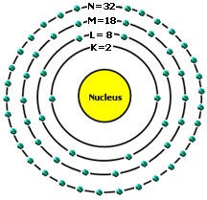
Arrangement of Electrons in Principal Energy Levels
Principal Energy Level | Alphabetical Label of Energy Level | Maximum number of Allowed Electrons (2n²)
1 | K | 2
2 | L | 8
3 | M | 18
4 | N | 32
5 | O | 50
6 | P | 72
7 | Q | 98

Slide 29
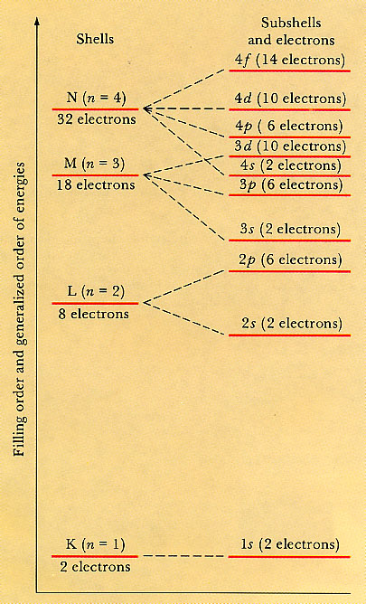
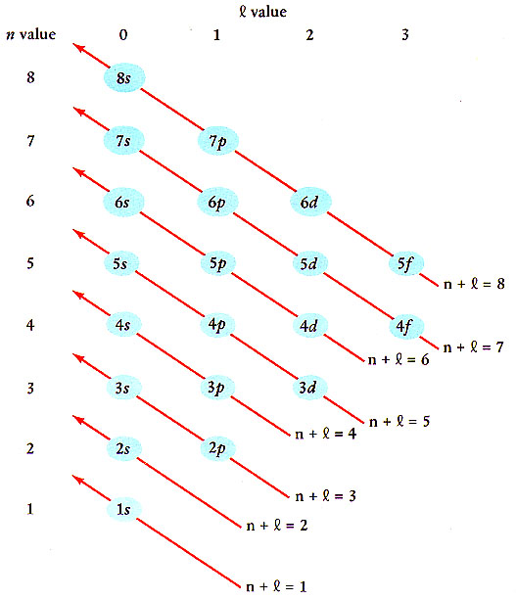
Shell and Subshell
Structure
Atomic Energy Levels
according to the
(n + l) rule
Buildup (aufbau) Principle
Max. no of e⁻ in a shell = 2n²

Slide 30
Azimuthal/Angular/Orbital Quantum number
The angular momentum quantum number, is denoted by the letter “l“ .
It specifies the angular momentum of orbiting electrons.
It also specifies their energy to less extent (not as much as “n”)
It has integer values of l= 0 to l= (n – 1).
For example, for a K shell, n=1 therefore l can only assume 0. For L shell, n=2 meaning that l can assume the values of 0 or 1.
What will be the possible values of l for N-shell?
l = 0, 1, 2, 3

Slide 31
Azimuthal/Angular/Orbital Quantum number
The sublevels – angular/azimuthal quantum number (l): specifies the shape of the orbitals.
There are four sublevels (s, p, d, f). S orbital does not have degenerate level while the remaining three sublevels have degenerate orbitals (same energy level).
For convenience sake, letters are used to specify the electronic state (orbit) in a given shell (characterized by n) corresponding to the second quantum number l:
For l = 0 = S orbital
l = 1 = P orbital
l = 2 = d orbital
l = 3 = f orbital
Ex: An electron with n= 2 and l = 0 is called a 2S electron (S orbital of L-shell)
What If n = 4, and l = 2?
= 4d electron

Slide 32
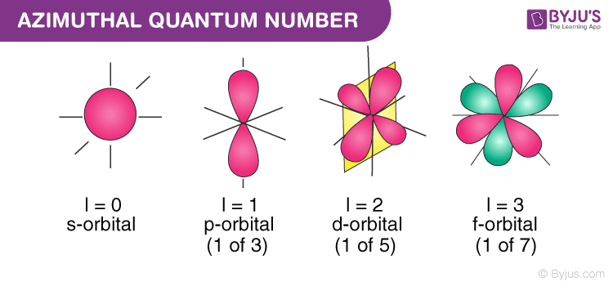

Slide 33
Magnetic Quantum number
The magnetic quantum number is denoted by “m_{l}”
It controls the number of allowed spatial orientations (“degeneracy”) of each orbit (characterized by l) in a given shell.
Degenerate orbitals: are orbitals with the same energy but different spatial orientation.
In the presence of magnetic field, degeneracy disappears as different spatial orientation of orbits assumes different energy values.
For any orbital characterized by l, the maximum number of orbital spatial orientations allowed is given by (2l+1) i.e. m_{l} = l, (l-1), (l-2),…0, -1,-2,… -l. They basically have integer values of -l to 0 to l

Slide 34
Magnetic Quantum number
For S orbital, remember that the value of l = 0, this implies that m_{l}= 0. This interprets that S orbital is oval/spherical in shape hence it has no directional orientation in space.
A D orbital (l = 2) allows m_{l} values between -2, -1, 0, 1, 2. Each of the 5 “supposed degenerate orbitals” will have a maximum of 2 electrons. Thus bringing the total possible number of electrons in this d-orbital to 10.
Each degenerate sublevel have a maximum number of electrons it can contain: s - 2e⁻, p - 6e⁻, d - 10e⁻, and f - 14e⁻.
Atomic electron orbitals are defined by n, l and m quantum numbers in terms of the sizes, shapes, and spatial orientations of the orbital respectively. However, none could define the direction of electronic spin around its own axis. Hence, the need for a fourth quantum number.

Slide 35
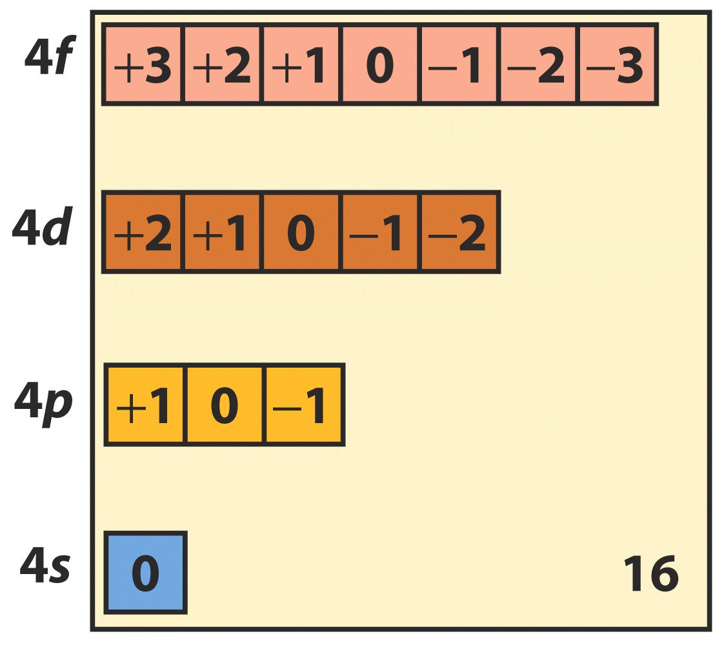
Magnetic Quantum number- The energy of subshells increase with l for a given value of n

Slide 36
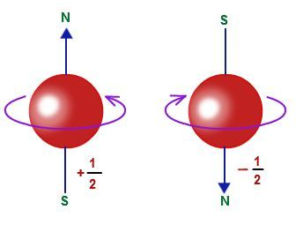

Electron Spin Quantum number
An electron spins around an axis & has both angular momentum and orbital angular momentum (as shown).
For an orbiting electron, the Electron Spin quantum number “S or m_{s}” defines the direction of electronic spin around its own axis.
It has little physical meaning, can have values of either +1/2 (parallel spin) and –1/2 (anti-parallel spin).
For notational purposes, a positive s is conveniently represented as (↑) and a negative s as (↓).
Electron Spin around its axis

Slide 37
So why does the spin quantum number have values of either +1/2 or -1/2?
Answer:
Remember that an electron spins around an axis & has both angular momentum and orbital angular momentum.
So because angular momentum is a vector quantity, the spin quantum number(s) has both magnitude (1/2) and direction (+ or -). Electron can spin only in 2 directions: clockwise and anticlockwise.

Slide 38
Quantum numbers Explained
Quantum numbers are important because they can be used to
determine the electron configuration of an atom
determine the probable location of the atom's electrons
understand other characteristics of atoms, such as ionization energy and the atomic radius.

Slide 39
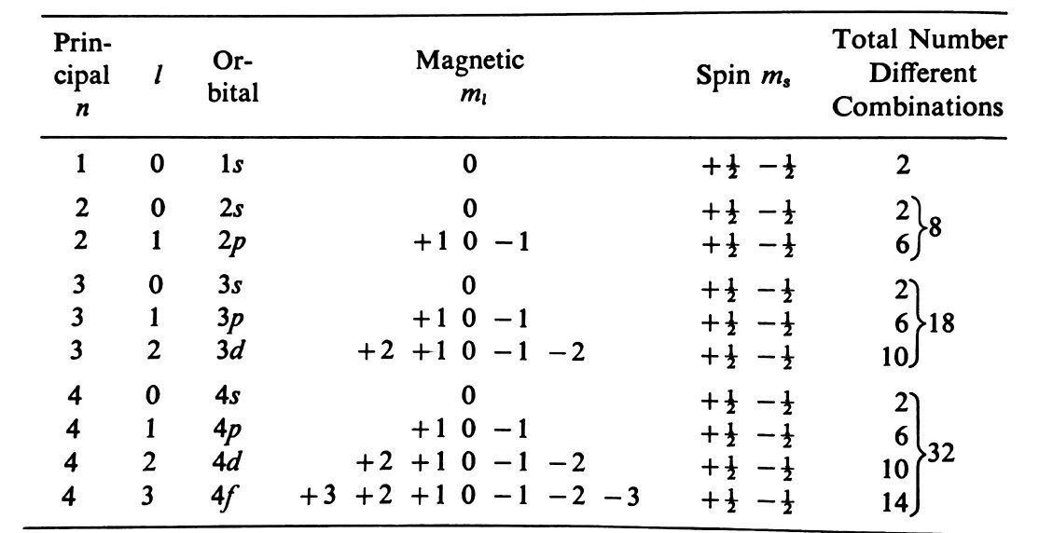
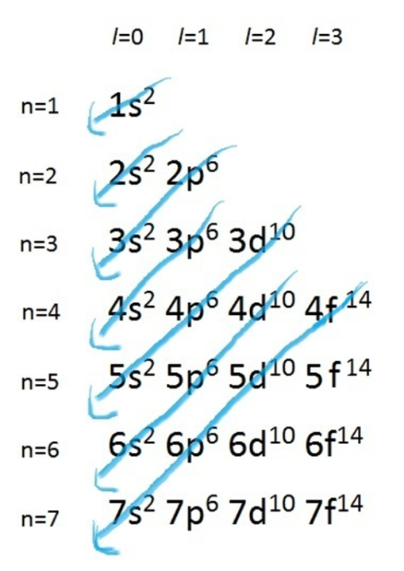
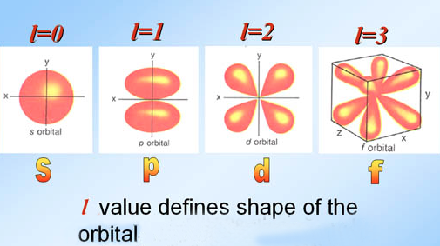
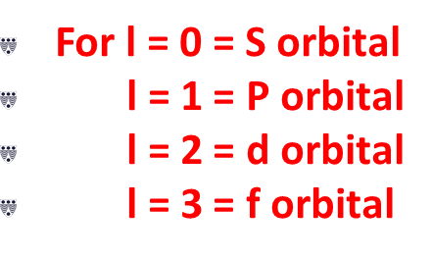
Quantum numbers Explained
Recall: For convenience sake, letters are used to specify the electronic state (orbit) in a given shell (characterized by n) corresponding to the second quantum number l:

Slide 40
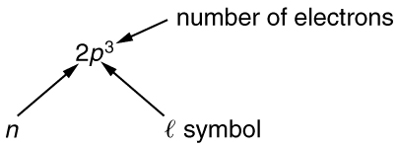

Slide 41
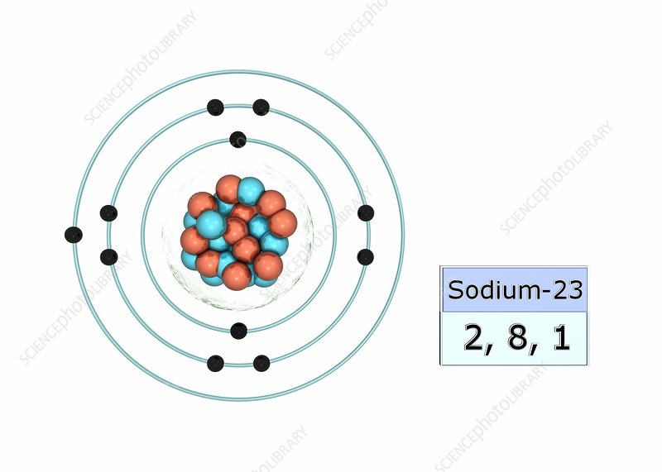
Building up electron configurations
An electron configuration is a list of the occupied orbitals and the number of electrons in each.
Electronic configuration of an atom is written in accordance with the number of electrons found in each energy level available in the atomic structure of an element starting with the energy level numbered 1 or K
For example ²³₁₁Na = 2, 8, 1
[Ne] 3s¹
1s²2s²2p⁶3s¹ - How do we achieve this?
Some important laws enable us to make use of these quantum rules for the characterization of electronic states in multi-electron systems:

Slide 42
Principles that govern the arrangement of electrons in an atom
Electrons are arranged in an orbital by three principles
the Aufbau Principle
the Pauli-Exclusion Principle
Hund's Rule.
Aufbau Principle
The Aufbau Principle, also called the building-up principle, states that electrons occupy orbitals in order of increasing energy. The order of occupation is as follows:
1s<2s<2p<3s<3p<4s<3d<4p<5s<4d<5p<6s<4f<5d<6p<7s<5f<6d<7p

Slide 43
Principles that govern the arrangement of electrons in an atom
The Aufbau or building principles shows that electrons are filled into orbitals in order of increasing energy
The ground state electron configuration is built by filling the lowest energy orbitals first while obeying the other 2 laws (Pauli principle and Hund’s rule).
The electron configuration of lowest energy is termed the ground state electronic configuration.
The build-up of the electronic states of an atom is obtained by placing the electrons first in the orbitals of lowest energy (the build-up principle or “construction principle”).
For example ²³₁₁Na = 1s²2s²2p⁶3s¹

Slide 44
Principles that govern the arrangement of electrons in an atom
What is the ground-state electron configuration of the element Kr?
(Kr = 36)
Long Method
1s² 2s² 2p⁶ 3s² 3p⁶ 4s² 3d¹⁰ 4p⁶
Short Method
[Kr]
OR
[Ar]4s² 3d¹⁰4p⁶

Slide 45
Principles that govern the arrangement of electrons in an atom
To determine a ground state electronic configuration, the n + l rule is employed to determine the relative energies of the atomic orbitals from 1s to ….. the lowest value of (n + l) has the lowest energy.
Examples with (n + l)
1s (1 + 0) < 2s (2 + 0) < 3s (3 + 0) < 3p (3+1) ,< 4s (4 + 0) < 3d (3 + 2) < 4p (4 + 1)
When n + l is the same for two orbitals, the orbital with the higher value of n has the higher energy (A few exceptions exist).
After determining the energy levels of shells and orbitals, we can now start filling the orbitals with the lowest energy first (Aufbau law).
Now let us see what sodium will look like

Slide 46
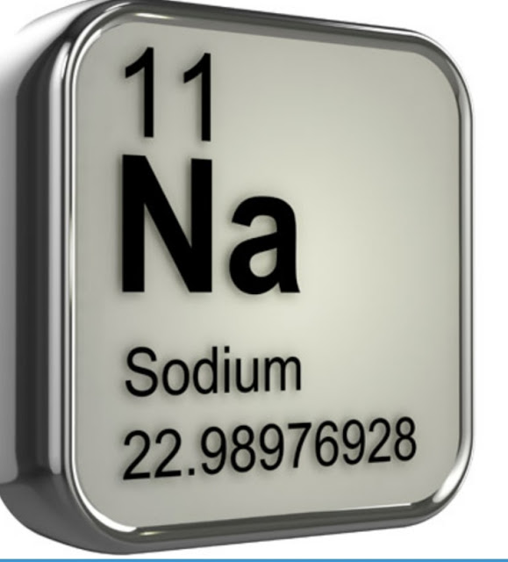
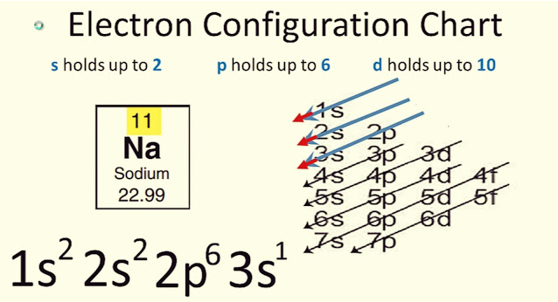
Principles that govern the arrangement of electrons in an atom

Slide 47
Principles that govern the arrangement of electrons in an atom
(2) Pauli’s exclusion principle: Electron spins on its axis and hence generates magnetic and electric fields. Electrons in the same degenerate orbital repel each other and therefore will have opposite spin numbers to be able to reside in the same orbital. Hence Pauli formulated the following rules:
(i)The maximum number of electrons in a degenerate orbital is two.
(ii) The two electrons in a degenerate orbital have opposite quantum spin numbers (+/-). Each spin is represented by half headed arrows.
(iii) No two electrons have all four principal quantum numbers as the same.

Slide 48
Principles that govern the arrangement of electrons in an atom
The Pauli principle is based on the fact that the separate existence of any electron depends upon its non-destruction by interference, i.e. on its wave nature.
For example, hydrogen has 1 electron in its K shell, so the electron assumes n = 1; hence l = 0 and m = 0; also, s = +1/2.
But for helium with 2 electrons in its “s” orbital, the first electron assumes the same quantum numbers as that of hydrogen i.e. n = 1; hence l = 0 and m = 0; also, s = +1/2. Whereas the 2nd electron assumes a different set of quantum numbers i.e. n = 1; hence l = 0 and m = 0; also, s = -1/2.

Slide 49
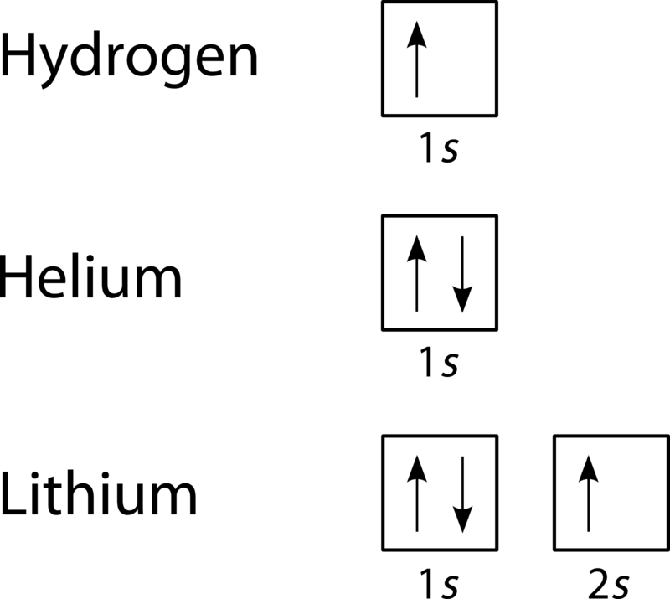
Principles that govern the arrangement of electrons in an atom

Slide 50
Principles that govern the arrangement of electrons in an atom
(3) Hund’s rule (the principle of maximum multiplicity): degenerate orbitals (m_{l} levels) are singly filled (with unpaired spins and spin quantum number equal to +1/2) before pairing up.
As a result, an atom tends to have as many unpaired electrons as possible. In order words, electrons avoid repelling each other by seeking out empty shells to fill up instead of pairing up.
Only after all m levels associated with a particular l value in a given shell have been used for single-electron occupation does doubling of electrons into m levels occur.
For example, the extra electron for carbon (atomic number 6) has the quantum numbers n = 2, l = 1, m = 0, s = +1/2 rather than n = 2, l = 1, m = –1, s = –1/2.

Slide 51
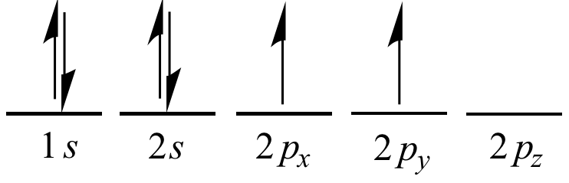
Principles that govern the arrangement of electrons in an atom
Filling of Carbon orbitals using the quantum theories and Hund’s rule

Slide 52
Principles that govern the arrangement of electrons in an atom
Are the following two states allowed for N by the Pauli principle?
1s²2s²2p_{x}¹2p_{y}¹2p_{z}¹ or 1s²2s²2p_{x}²2p_{y}¹2p_{z}⁰
Which is more stable and why?
1s²2s²2p_{x}(↑)2p_{y}(↑)2p_{z}(↑) is more stable than
1s²2s²2p_{x}(↑↓)2p_{y}(↑)2p_{z}()
^{Half-filled P orbital}

Slide 53
Principles that govern the arrangement of electrons in an atom
Recap
The state of an electron in an atom is completely described by a complete set of quantum numbers. This set is written as (n, l, m_{l}, m_{s}).
The Pauli exclusion principle says that no two electrons can have the same set of quantum numbers; that is, no two electrons can be in the same state.
This exclusion limits the number of electrons in atomic shells and subshells.
Each value of n corresponds to a shell
Each value of l corresponds to a subshell.
The total number of possible orbitals with the same value of l (a subshell) is 2l + 1
The maximum number of electrons that can be in a subshell is 2(2l + 1).
The maximum number of electrons that can be in a shell is 2n².

Slide 54
Question: (a) How many electrons can be in the n=4 shell?
(b) What are its subshells, and how many electrons can be in each?
Ans. (a) 32.
(b) 2 in s; 6 in p; 10 in d, and 14 in f, (for a total of 32).
i.e. 4s², 4p⁶, 4d¹⁰ and 4f¹⁴

Slide 55
NOTE
The total number of possible orbitals with the same value of l (a subshell) is 2l + 1. Thus there is:
one s-orbital for m_{l} = 0; there are
three p-orbitals for m_{l} = 1,
five d-orbitals for m_{l} = 2,
seven f-orbitals for m_{l} = 3, and so forth.

Slide 56

Sublevels | Corresponding Angular quantum # (l) | # of Degenerate Orbitals (2l +1) | Max # of Electrons/sublevel 2(2l+1) | Designation of a filled Orbital
S | 0 | 1 | 2 | s²
P | 1 | 3 | 6 | p⁶
D | 2 | 5 | 10 | d¹⁰
F | 3 | 7 | 14 | f¹⁴
Question: Show diagrammatically how the subatomic particles are arranged in the following atoms. Also show the electronic structure for each of them.
(a) ₁₁ ²³Na (b) ₁ ¹H (c) ₈ ¹⁶O
(b) State the electronic configuration and the principal energy levels at which the outermost electron can be found in each atom, then calculate the maximum number of electron allowed in this principal energy level,

Slide 57
Principles that govern the arrangement of electrons in an atom
The Aufbau Principle states that electrons occupy orbitals in order of increasing energy.
Hund's Rule states that if 2 or more degenerate (i.e. same energy) orbitals are available, one electron goes into each until all of them are half full before pairing up.
The Pauli Exclusion Principle states that no two electrons can be identified by the same set of quantum numbers i.e. two electrons in an orbital must have opposite spins.

Slide 58
Quick Check
1. If n=3, and l=2, then what are the possible values of m_{l} ?
2. List the possible combinations of all four quantum numbers when n=2, l=1, and m_{l}=0 .
3. Can an electron with ms =1/2 have a downward spin?
4. What is the name of the orbital with quantum numbers n=4 and l=1?
5. What is the name of the oribital(s) with quantum number n=3?
6. Suppose that all you know about a certain electron is that its principal quantum number is 3. What are the possible values for the other four quantum numbers?
7. Is it possible to have an electron with these quantum numbers: n=2 , l=1 , m_{l}=3 , ms =1/2? Why or why not?
8. Is it possible to have two electrons with the same n , l , and ml ?

Slide 59
Quick Check
9. How many subshells are in principal quantum level n=3 ?
10. What type of orbital is designated by quantum numbers n=4 , l=3 , and ml=0?
11. An electron in a hydrogen atom finds itself in the fourth energy level.
Write down a list of the orbitals that it might be in.
Can it be in all of these orbitals at once?
Can you tell which orbital it is in?

